Slide 1
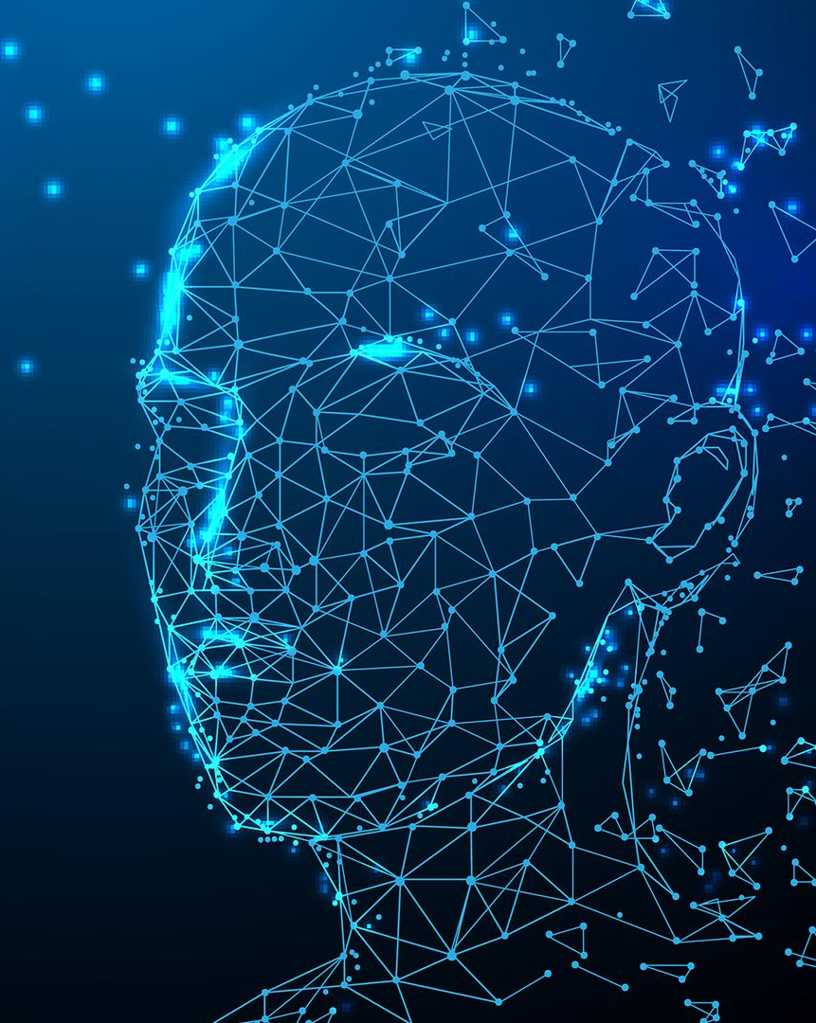
Artificial intelligence for nano-engineering
By James Ryan
Computational Modelling of Nanosystems Seminar 06/01/2025

Slide 2
Introduction
Nano-Engineering is a rapidly developing field which demonstrates great potential in various scientific fields, due to nanomaterials having unique chemical and physical properties.¹
Traditional analytical tools and simulations are resource consuming and can be inaccurate. The use of AI in nanoscience can be used to further accelerate scientific discoveries.

Slide 3
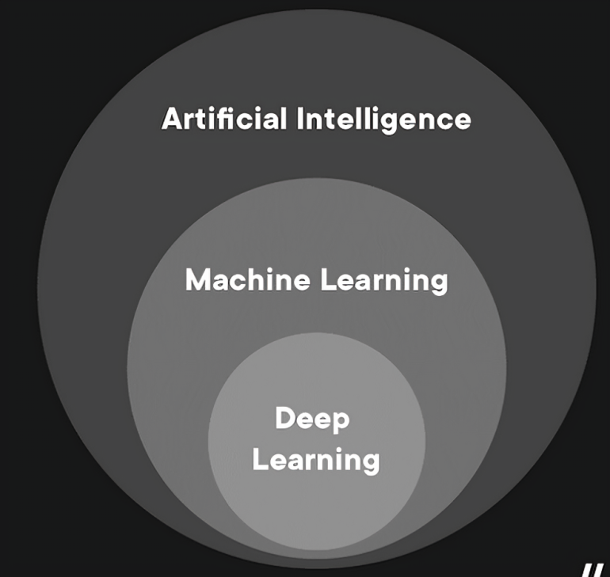
What is AI?
Artificial Intelligence - the simulation of human intelligence in computational systems, enabling them to learn, reason, and solve problems.²
Machine Learning – algorithms to detect patterns in data sets with the ability to learn and adapt.
Deep Learning – use of artificial neural networks for in-depth analytical tasks, with the ability to self train.

Slide 4
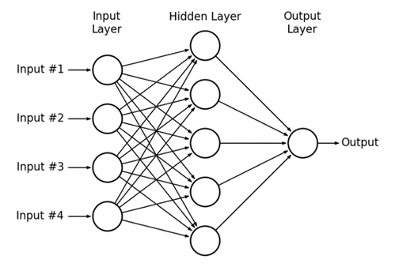
Artificial neural networks
A subset of Machine Learning of computational models which consist of layers of interconnected nodes (neurons) that process and transform data, directly inspired by the structure of the human brain.⁴
Fig.1: Schematic of the typical structure of an artificial neural network (ANN)⁶

Slide 5
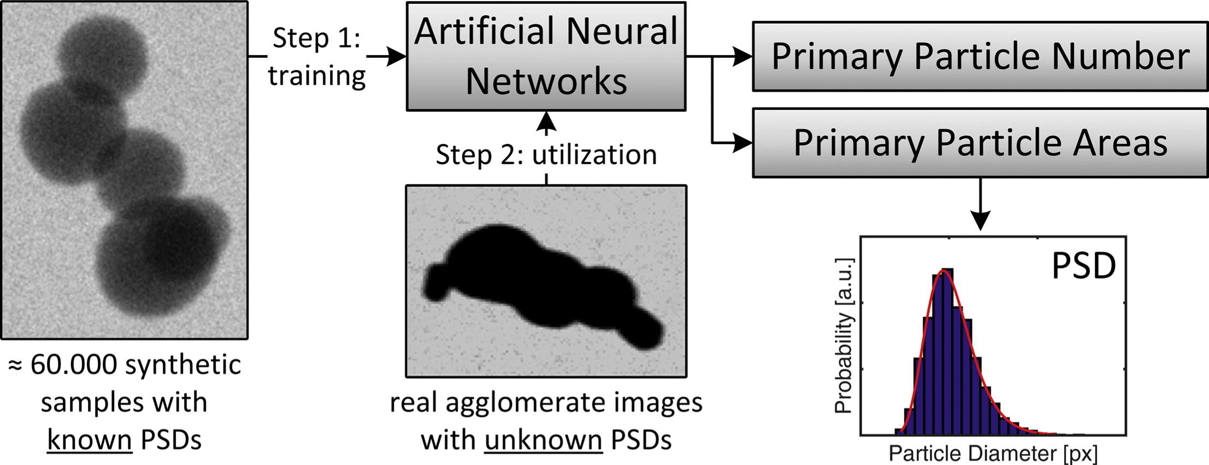
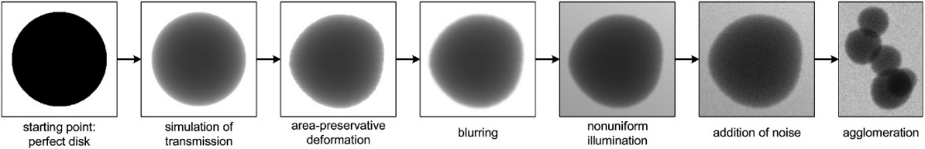
Ai for Nano-engineering
Case study: Particle size analysis of agglomerates on TEM images via Artificial neural networks
An algorithm is proposed using the combination of regression and classification ANNs to detect the size and number of particles in an agglomerate respectively. Synthesised TEM images are produced as training data.⁵
Fig.2: Workflow to find size distributions of agglomerated nanoparticles in TEM images using an ANN algorithm
Fig.3: Elementary steps of the image synthesis of agglomerated nanoparticles for TEM images

Slide 6

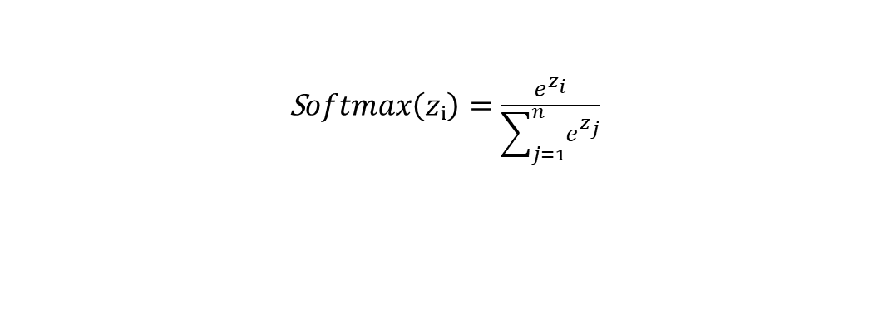

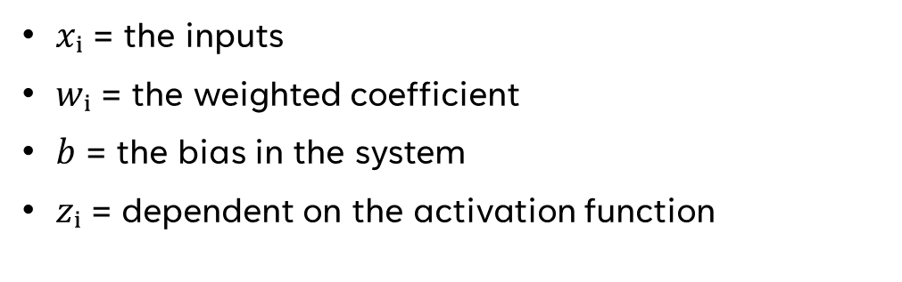
The proposed ANN model
Classification ANN for # of particles in agglomerate
# regressions ANNs for particles in agglomerate
Both models have input, hidden, and output layers. Input layer has 13 nodes for agglomerate features, while the hidden layer ranges from 11–124 nodes based on ANN type and particle count. A hyperbolic tangent activates the hidden layer, and SoftMax handles the output. Data was split 70/30 for training and testing.
$$z_{i} =\sum_{i=0}^{n}{x_{i} w_{i}}+b$$
$$HypTan(zᵢ)=\frac{e^{zᵢ}−e^{−zᵢ}}{e^{zᵢ}+e^{−zᵢ}}$$
$xᵢ$ = the inputs
$wᵢ$ = the weighted coefficient
$b$ = the bias in the system
$zᵢ$ = dependent on the activation function
S$oftmax\left(zᵢ\right)=\frac{e^{z_{i}}}{\sum_{j=1}^{n}{e^{z_{j}}}}$

Slide 7
Results
Table 1: Comparison of GSD and GMD errors for different agglomerate analysis techniques
500 real TEM images of agglomerated species were tested on the trained ANN. Results are shown as the relative errors of the geometric mean diameter and geometric standard deviation compared to a ground truth. The ANN model achieves accuracy near to that of a manual operator, and greatly exceeding conventional autonomous techniques.
Method | GMD Error | GSD Error
Proposed ANN ML Model | 4.1% | 5.1%
Watershed transformation⁷ | -11.6% | 6.1%
Hough transformation⁸ | -20.1% | 8.7%
Test person | -4.3% | -1.0%

Slide 8



Any Questions?
james-luke.RYAN@etu.univ-amu.fr
ORCID: 0009-0000-6386-6707

Slide 9
Bibliography
[1]-Micro and Nano Engineering | Journal | ScienceDirect.com by Elsevier. https://www.sciencedirect.com/journal/micro-and-nano-engineering (accessed 2024-12-14).
[2]-Sheikh, H.; Prins, C.; Schrijvers, E. Artificial Intelligence: Definition and Background. 2023, 15–41. https://doi.org/10.1007/978-3-031-21448-6_2.
[3]-Sarker, I. H. Machine Learning: Algorithms, Real-World Applications and Research Directions. SN Comput Sci 2021, 2 (3), 160. https://doi.org/10.1007/s42979-021-00592-x.
[4]-Montesinos López, O. A.; Montesinos López, A.; Crossa, J. Fundamentals of Artificial Neural Networks and Deep Learning. Multivariate Statistical Machine Learning Methods for Genomic Prediction 2022, 379–425. https://doi.org/10.1007/978-3-030-89010-0_10.
[5]-Frei, M.; Kruis, F. E. Fully Automated Primary Particle Size Analysis of Agglomerates on Transmission Electron Microscopy Images via Artificial Neural Networks. Powder Technol 2018, 332, 120–130. https://doi.org/https://doi.org/10.1016/j.powtec.2018.03.032.
[6]-Basic Structure of Artificial Neural Networks | by Beyza Ecem Erce | Data Science Earth | Medium. https://medium.com/datasciencearth/basic-structure-of-artificial-neural-networks-9aef29df9d (accessed 2024-12-14).
[7]-Jung, C.; Kim, C. Segmenting Clustered Nuclei Using H-Minima Transform-Based Marker Extraction and Contour Parameterization. IEEE Trans Biomed Eng 2010, 57 (10 PART 2), 2600–2604. https://doi.org/10.1109/TBME.2010.2060336.
[8]-Ballard, D. H. Generalizing the Hough Transform to Detect Arbitrary Shapes. Pattern Recognit 1981, 13 (2), 111–122. https://doi.org/10.1016/0031-3203(81)90009-1

